Slide 1
3.DC Motor Frequency Response
GODAVARTHI AAHLADH 2018HT01513

Slide 2
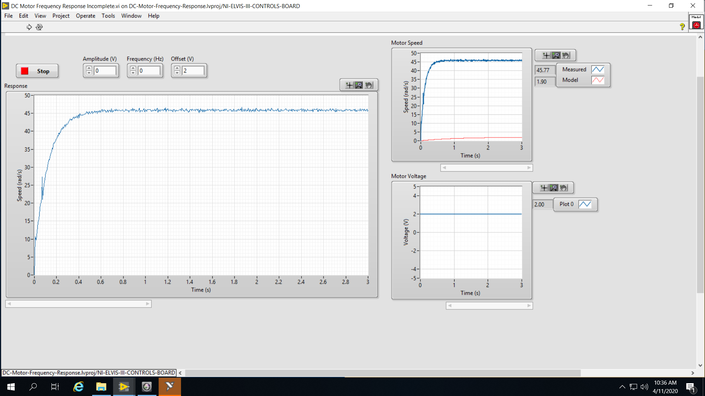
3-1 Response of the system to a constant input.

Slide 3
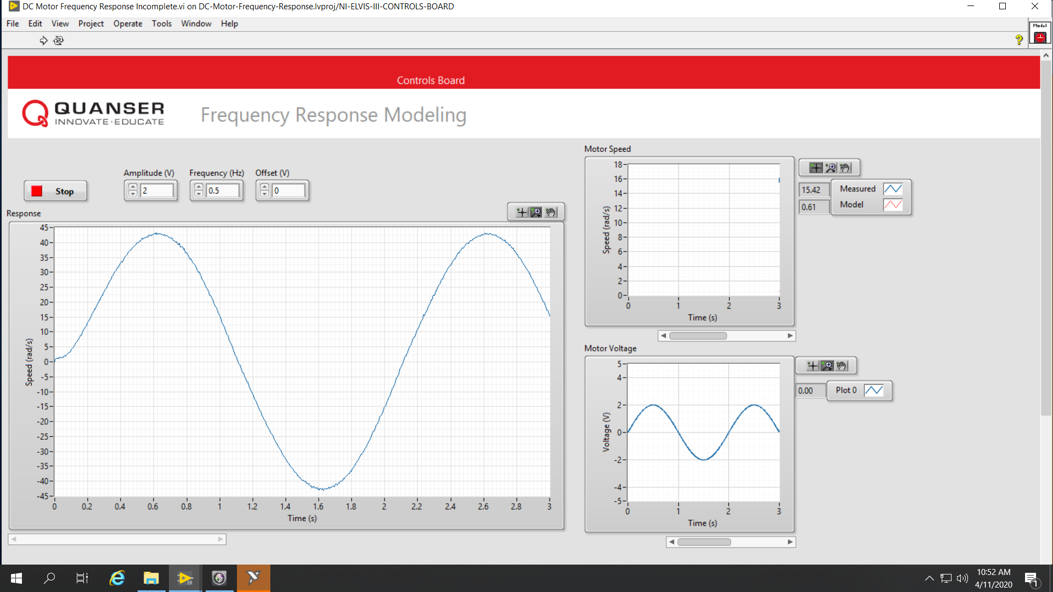
3-2 Response of the system to a sinusoidal input

Slide 4
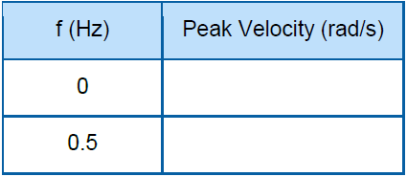
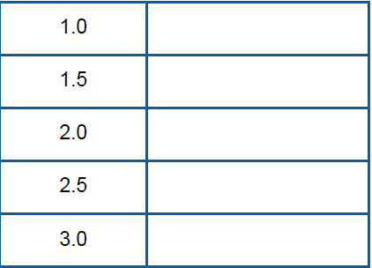
3-3 Frequency response data
47
43.2
37.9
33.36
29.6
26.7
23.88

Slide 5
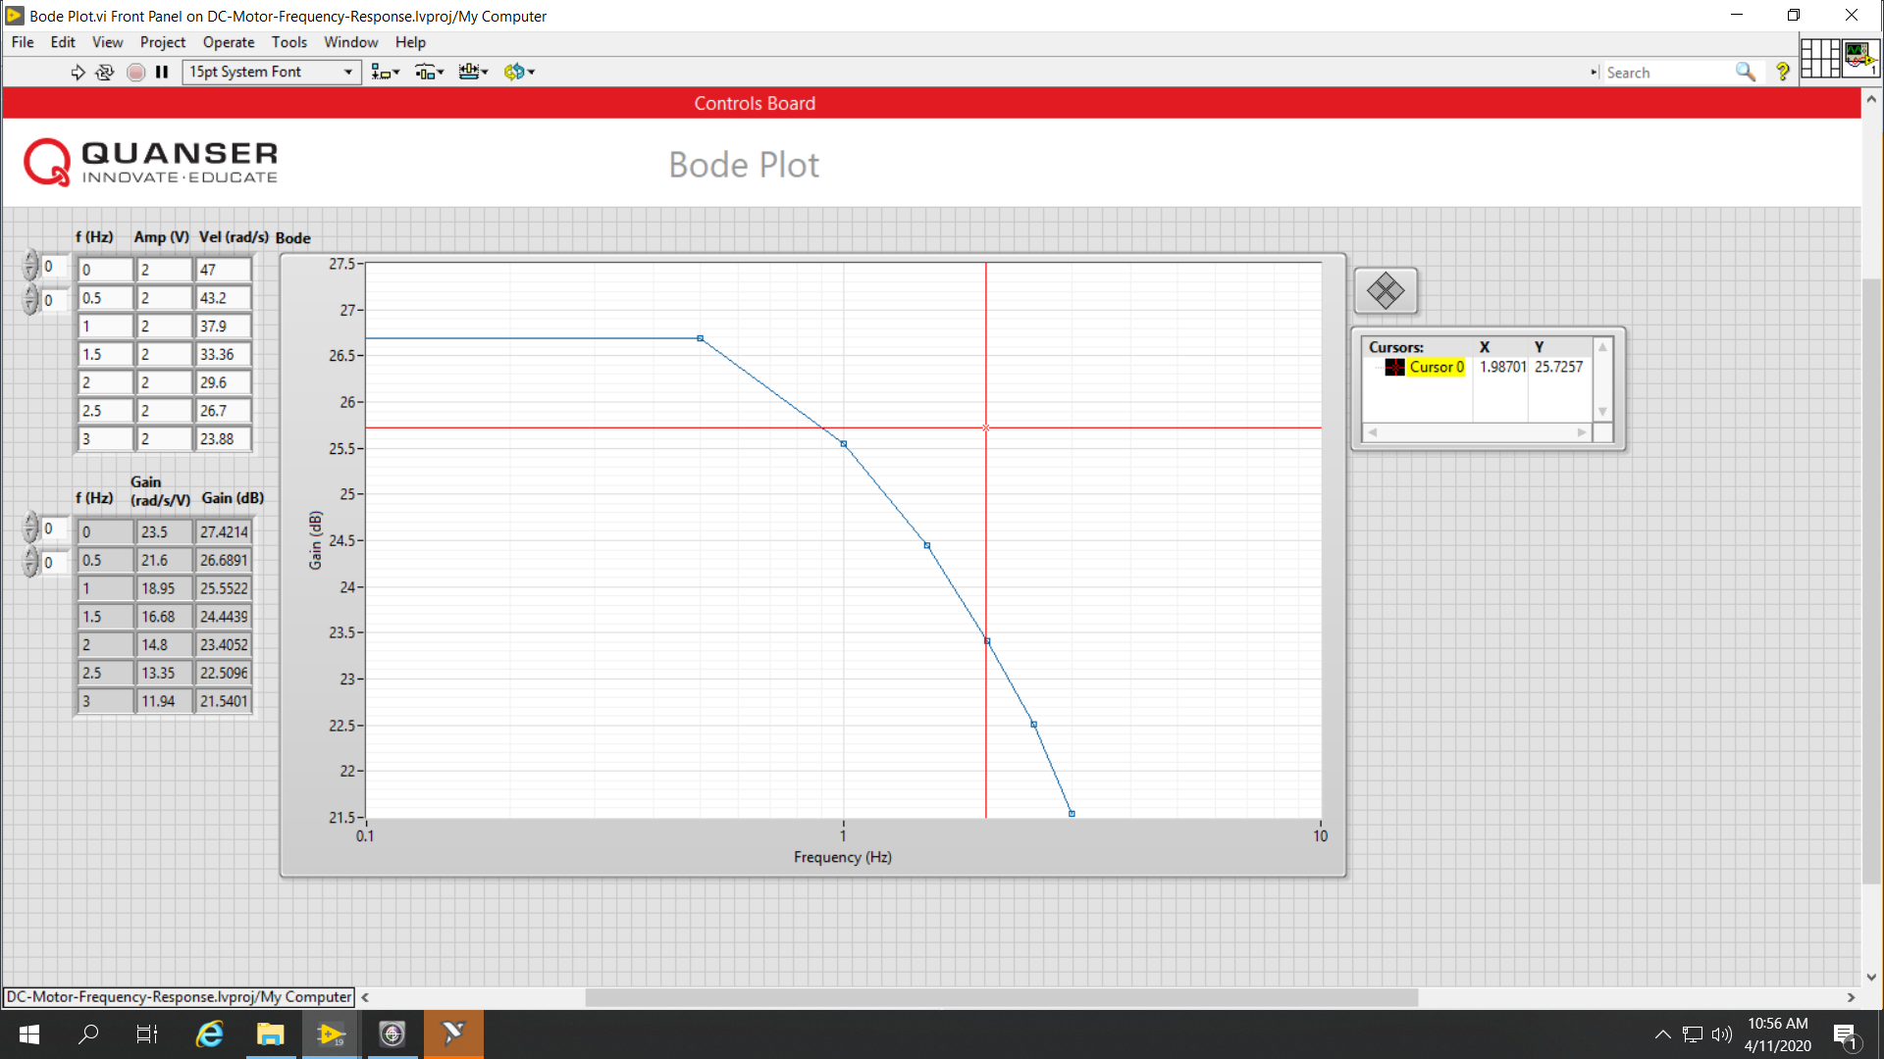
3-4 Bode Plot

Slide 6
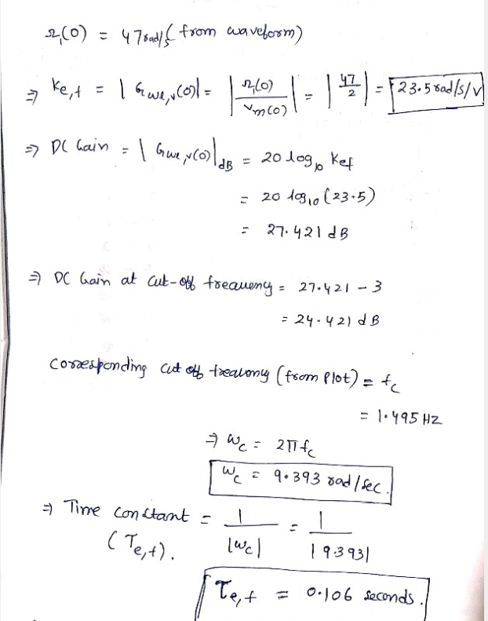
3-5 Sample calculations

Slide 7
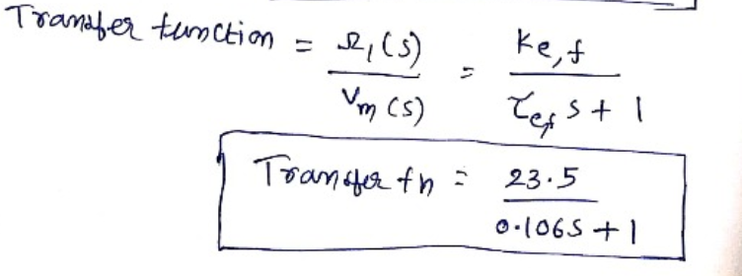
3-6 Transfer Function model

Slide 8
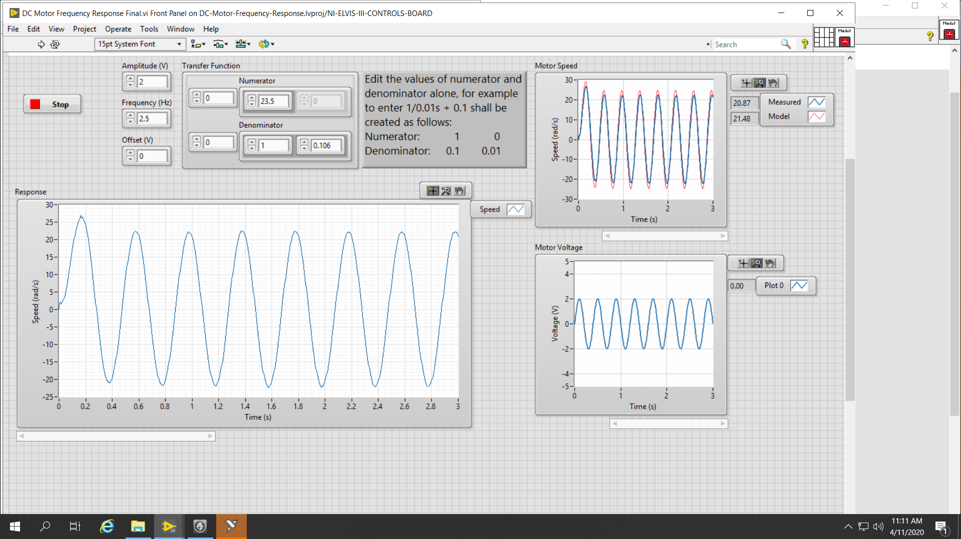
3-7 Modelled vs Actual response

